Slide 1
Seismocardiogram (SCG) Signal Quality Indexing (SQI) Evaluation
4/1/2024

Slide 2
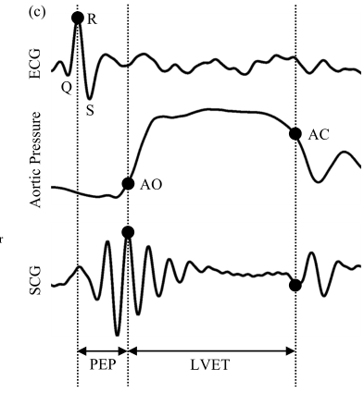
Goals
Generate an automated way to determine if SCG signals are good quality or not
Need a fast way to annotate SCG quality and AO/AC points for training ML/DL models
Go over existing annotation code
Go over SCG SQI Rubric created for DARPA nVNS dataset
Aortic Valve Closure
Aortic Valve Opening

Slide 3
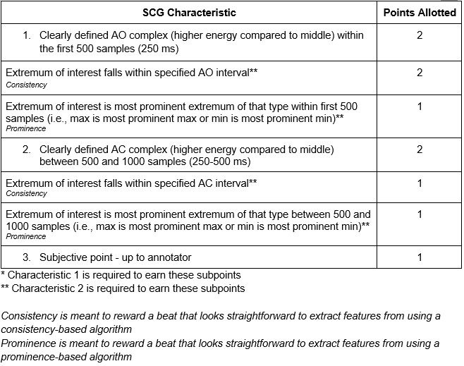
SCG Rubric
Samples assumes 2000Hz
Total: 10
Grade SCG beats by:
AO/AC Complex signal-noise-ratio (SNR) (most important)
AO/AC consistency and prominence
Value signal quality and feature quality

Slide 4
Annotation Code Flow Chart
Random N Beats
SCG Beat Visualization
SCG Beats
1 subject
Set AO/AC Visualization Bounds
Score Beats
Labels
1
2
Every M beats
3 stages:
1. Warmup stage
Initialize AO/AC visualization regions
Cycle through random SCG beats (prime annotator on what the SCG looks like for this subject)
2. Scoring stage
Beats are fed in order and scored 1 by 1
3. Reannotation stage
Reannotate a few previously annotated beats (intra-annotator agreement)
Reannotate
Reannotation
Labels
3

Slide 5
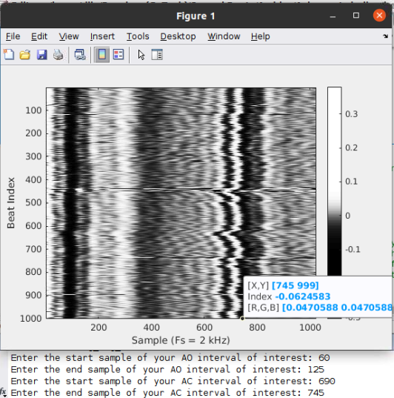
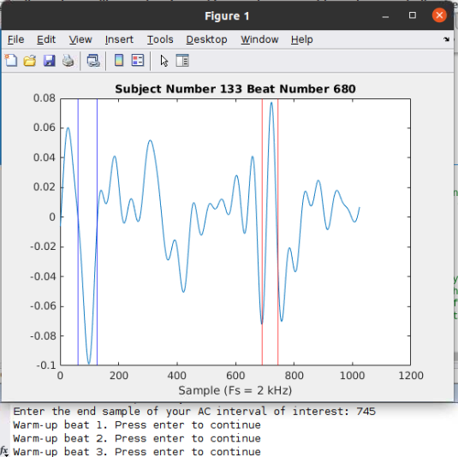
Annotation Flow Chart
Random N Beats
SCG Beat Visualization
SCG Beats
1 subject
Set AO/AC Visualization Bounds
Score Beats
Labels
1
2
Every M beats
Reannotate
Reannotation
Labels
3
Plots
MATLAB Terminal User Input

Slide 6
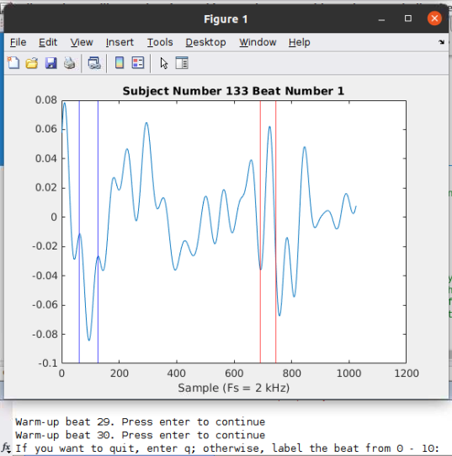
Annotation Flow Chart
Random N Beats
SCG Beat Visualization
SCG Beats
1 subject
Set AO/AC Visualization Bounds
Score Beats
Labels
1
2
Every M beats
Reannotate
Reannotation
Labels
3
MATLAB Terminal User Input

Slide 7
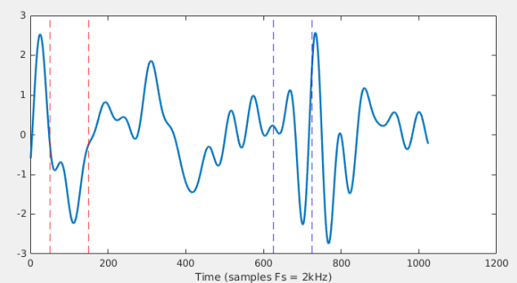
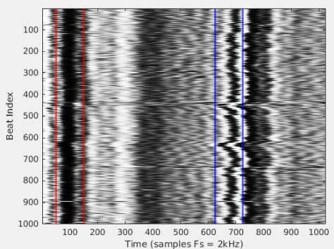
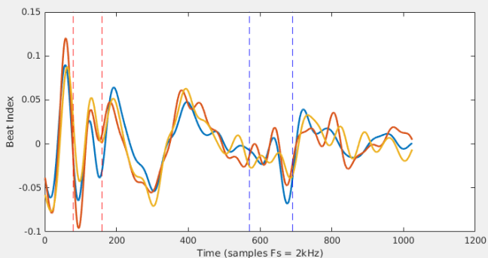
Good Quality
Beat 2
AO Region distinguishable (+2)
Extremum of interest visible in AO range (+2)
Extremum of interest prominent (+1)
AC Region distinguishable (+2)
Extremum of interest visible in AC range (+1)
Extremum of interest prominent (+1)
Annotator Point (+0) AO region visually look weird
Total Score: 9
Notes:
S125

Slide 8
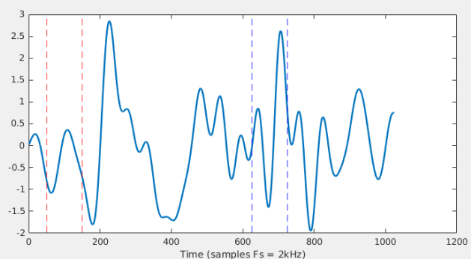
Mid Quality
Beat 335
AO Region distinguishable (+2)
Extremum of interest visible in AO range (+0)
Extremum of interest prominent (+0)
AC Region distinguishable (+2)
Extremum of interest visible in AC range (+1)
Extremum of interest prominent (+0)
Annotator Point (+0) AO region visually look weird
Total Score: 5
Notes:
S125

Slide 9
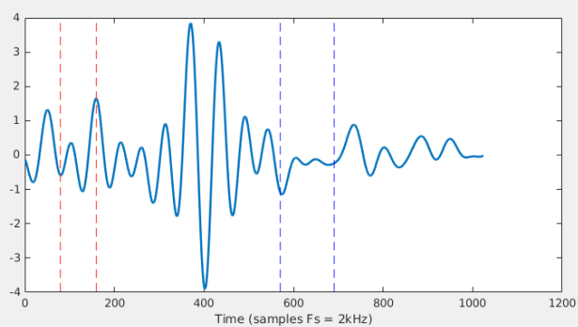
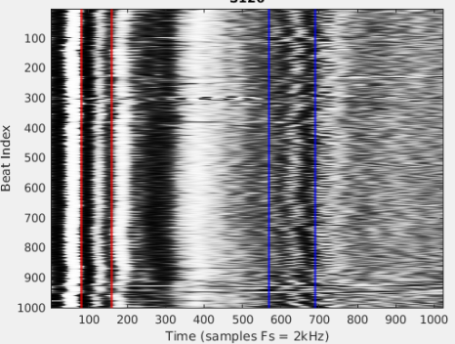
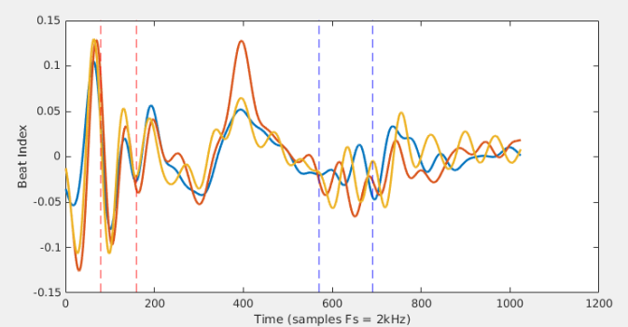
Poor Quality (0-3)
AO Region distinguishable (+0)
Extremum of interest visible in AO range (+0)
Extremum of interest prominent (+0)
AC Region distinguishable (+0)
Extremum of interest visible in AC range (+0)
Extremum of interest prominent (+0)
Annotator Point (+1) AO region still technically looks ok
Total Score: 1
Notes:
S126

Slide 10
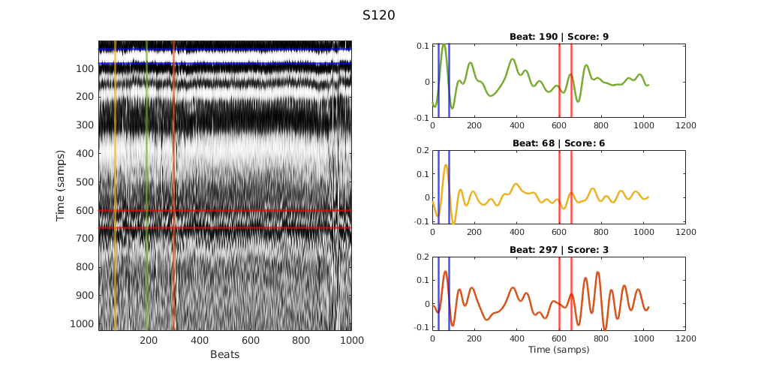
Example
Beat Heatmap
Beat 68
Beat 297
Subject 120
Beat 190
The beat heatmap is a matrix where each column is a SCG beat

